Slide 1
Facilitator Notes: Before the Meeting
Thoroughly review your school’s results with your school leadership team and decide which data points you will highlight for teachers as areas for celebration and priority areas for improvement. Determine which data points you’d like teachers to react to and provide further feedback. (Customize Slides 9-15; Guidance is provided on those slides)
Customize objectives (Slide 4), norms (Slide 7) and discussion questions (slides 14,20) to guide the conversation.
Take time to review Slide 7 and consider how you will open the conversation. Draft and rehearse talking points and norms that set expectations for discussion.
We recommend sharing the full printable school report with teachers prior to the meeting. Directions on how to download a PDF report, as well as email templates to share the report can be found in the Insight Help Center.

Slide 2
Facilitator Notes: During the Meeting
Be honest and authentic about your reactions to the results and how the leadership team plans to shift leadership practices to improve experiences for teachers.
As you solicit additional feedback from teachers, be clear about how that feedback will be considered. (Incorporate into talking points, as applicable)
It’s OK to not have all the answers in the moment and to tell teachers when you don’t. It’s much better than agreeing to something you can’t follow through on or might reconsider later.
Above all, listen to what your teachers have to say and allow them to have most of the air time.

Slide 3
Insight Survey Results
<School Name>
Update:
Change the subtitle to your school’s name
Update:
Change the date to the date you will present these slides to teachers.
Date
Notes:
“Thank you for completing the Insight survey, and for providing your honest and critical feedback of our work in the school. Your responses and comments are vital to our ability to continue to improve in our work.
Your feedback is important so we’re providing this in-person space to discuss the results together and think about next steps.
Let’s get started.”

Slide 4
Optional Update:
Customize these objectives and the agenda to meet your needs / goals for the meeting.
Objectives
Together we will:
Review our school’s Insight results and discuss teacher and leader reactions
Identify strengths and opportunities for growth; and
Discuss strategies for improvement
Notes:
“During our time together we will review our results and I’m going to share with you the leadership team’s reactions. We also want to give you the opportunity to say more so we have as much perspective as possible. We’d appreciate everyone’s candor and openness as we talk about what’s going well as well as areas we’d like to improve.”

Slide 5
Optional Update:
This agenda and timing is based upon a 45-minute meeting. As necessary, you may choose to extend or shorten the agenda. The “Overview” and “Unpacking” areas are the most essential, and should comprise the majority of the time during the session.
Adjust the timing on this slide, and all subsequent agenda slides, to match your planned session pacing.
Our Agenda
Introduction to Insight 5 minutes
Overview of our results 15 minutes
Unpacking our area for improvement 15 minutes
Q&A 5 minutes
Closing 5 minutes
Notes:
“We’ll start with a quick introduction to Insight to set the stage.”

Slide 6
Insight is a survey that asks teachers to reflect on instructional leadership practices.
Survey Teachers
Share Feedback
Improve Culture
Validated survey gathers teacher feedback on critical aspects of school culture
TNTP analyzes school culture data and shares feedback with school leaders
Survey results provide information to prioritize necessary actions to improve culture
Notes:
“To provide you with a little more context a third party (TNTP) collected your responses and then provided us with reports summarizing all teacher responses. Having a third party collect the data ensures confidentiality for teachers. There are minimum response rates required to receive a report, which ensures that results reflect the views of teachers overall. If we did not have enough teachers complete the survey, we would not have these results. I appreciate that you all took the time to respond.
Our leadership team has reviewed our school’s data to think about our next steps, as we remain focused on continual growth.
Today we want to give you additional opportunities to share feedback and help us determine how we can best use the results to prioritize actions to improve our school culture.”

Slide 7
By participating in Insight, you’ve helped inform the improvement of instructional culture at our school, and schools with stronger cultures provide better opportunities for students to excel.

Slide 8
Our Agreements | What they look like in action
Share the mic | Participate to the fullest of your ability while giving room for others to speak
Be engaged and maintain confidentiality | Make the personal commitment to remain involved in the dialogue. Seek to understand, not to agree. Honor privacy by avoiding “who said what.”
Speak to and listen for one’s own truth | Be open about your feelings and experiences – not just saying what you think others want to hear. Be open to the experiences of others, not comparing them to your own.
Expect and accept non-closure | This work is ongoing, there will be no “quick fixes” to the challenges we discuss. You may have thoughts and feelings that go unresolved today and will be a part of our ongoing work.
Norms
Optional Update:
Adjust these norms for ones you may already use at your school.
Notes:
“Before we get into our discussions today, we want to acknowledge that parts of the conversations may feel uncomfortable.
The data we’re going to be looking at represents different perspectives of how people experience our school culture. The point here is not to place blame or dwell on the past, but rather to look at what people’s current perceptions are and use that to move forward and improve outcomes.
Take a moment to read through this slide.
Do these feel right? Are there any other norms we would like to establish for today’s conversations?”

Slide 9
Our Agenda
Introduction to Insight 5 minutes
Overview of our results 15 minutes
Unpacking our area for improvement 15 minutes
Q&A 5 minutes
Closing 5 minutes
Optional Update:
Adjust the timing on this slide, and all subsequent agenda slides, to match your planned session pacing.

Slide 10
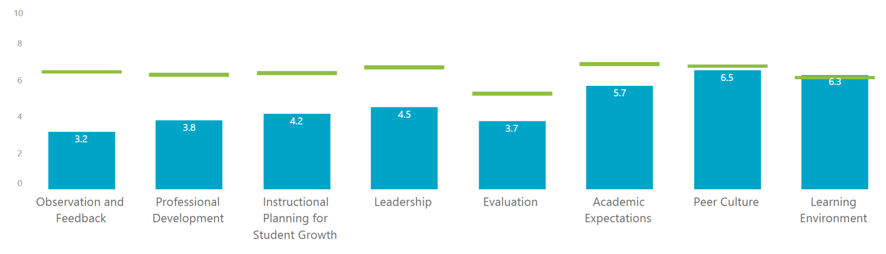
Getting Oriented to the Data: Domain Scores
Update:
Delete this screen shot and replace with a screenshot from your Insight report. Click here for a brief tutorial on how to quickly cut/paste a screen shot using the Snipping Tool.
Note: Depending on the available benchmarks, you may have a choice on how to filter your data in your school report. We encourage you to share the “Top-quartile” benchmark when sharing with teachers.
You can also choose how to order the data (Example: Lowest to Highest domain score, or Largest Gap to Smallest gap). Consider which order will be more impactful for your conversation with teachers.
Our School’s Domain Scores: A Domain score of ‘5’ represents the national average.
Top-Quartile Results: Represents the average domain score of top-quartile schools in <district/ network/ school group>
These benchmarks allow us to understand our school’s performance in comparison to local schools, in addition to schools nationally.
Update:
Adjust the green text to match what filters you selected.
Notes:
FACILITATION NOTES:
See the yellow box above for customization guidance. Depending on what options your district/network selected you will have choices on how to filter your data in your school report. Once you determine which filters will be best suited for presenting the information to your teachers, adjust the talking points below based on your context.
“I’d like to take a moment to orient you to what you are seeing.”
Option 1: (If “Top Quartile” Benchmark is selected)
“This table shows our school’s performance on the various aspects of instructional culture (blue bars), and the distance of our scores from the schools with the strongest instructional cultures in the district for each domain.” Top-quartile schools are the schools in our local area with the top 25% of Instructional Culture Index scores.
Option 2: (If “Average” Benchmark is selected)
“This table shows our performance on the various areas addressed by Insight, and the distance of our scores from the average of all schools in our district/network for each domain.
We can also see our school’s performance in comparison to the national context. A domain score of 5 represents the national average.”
Option 1: (If “Largest to Smallest Gap” is selected)
“The domains are ordered so we can see how far our school is from the given benchmark. The largest gap is shown on the far left, and the smallest gap is shown on the far right. We may want to consider focusing improvement efforts in areas where we see bigger gaps.”
Option 2: (If “Lowest to Highest” is selected)
“The domains are ordered so our lowest score is on the left and our highest score is on the right. Viewing them in order can help us visualize some areas of strength and opportunities for improvement.”

Slide 11
Initial Takeaways
Discussion Questions
What aspects of these results resonate or are surprising?
2. What stands out as our areas of strength or opportunities for improvement?
Update:
Delete this screen shot and replace with the screenshot you inserted on the previous slide.
Notes:
FACILITATION NOTES:
Identify (or ask for volunteers to identify)areas where:
School is performing close to or above district/network average, top quartile average, or national average (if domain score is 5 or above) CELEBRATE AS STRENGTHS
School is performing lower than district/network average, top quartile average, or national average (if domain score is below 5) CALL OUT AS OPPORTUNITIES
Example Commentary (adjust to fit your data):
“First let’s look at some areas of strength. We know the green line represents the top quartile schools in our district. Where are we close or above this average?
I also wanted to point out where we are in relation to the national context. Remember that a score of 5 represents the national average. Are there domains where we are performing above the national average? Let’s take a minute to celebrate that!
This graphic can also help us see opportunities for growth. What domains have the largest gap between our performance and the average of our top-quartile schools?
If the national average for domains is 5, are there domains where we fall below this mark?”
REVIEW “DISCUSSION QUESTIONS”
“Reflect on the pre-work from this meeting when you reviewed individual survey question results.”
Solicit responses from teachers to discussion questions.
SPECIAL CONSIDERATION:
If your school’s domain scores are very low, develop talking points which frame the discussion positively. For example: “Our scores are currently lower than the district/network average in most areas, and I’m concerned about that. I want you to know how seriously our leadership team considers this feedback and that we’ll use this as a starting point for improvement. We sincerely want all our staff to have positive experiences so that we can better support our students. Your engagement in this conversation will help us focus on the right things.”

Slide 12
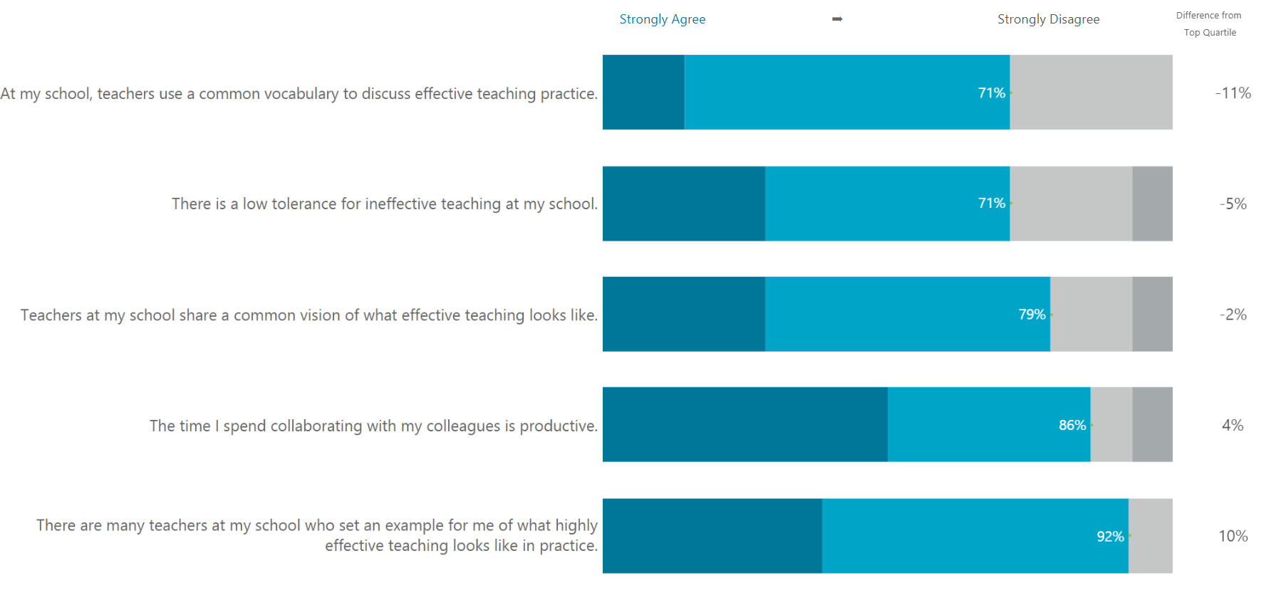
An Area of Strength: Peer Culture
Update:
Replace “Peer Culture” in the title with the area of strength you identified.
Update:
Delete this screen shot and replace with a screenshot from your school report. Click here for a tutorial on how to cut/paste a screen shot using the Snipping Tool.
Notes:
“Prior to the meeting the leadership team selected an area of strength to discuss further. Here are all of the data points related to this area of strength. I’d like you to take a minute now to review these items, and I’d love to hear a few take-aways you see in this information, particularly why this is going well and how we can leverage this strength to improve our instructional culture.”
FACILITATION NOTES:
What is the impact on teachers, and on students, of this strength?
How have we gotten to where we are?
How can we continue to improve? What’s next?
Consideration for Day of Session: It’s possible that during the discussion on Slide 10 teachers elevated different areas of strength. Be aware of other Domains teachers may want to discuss deeper and determine how the discussion may need to shift in response. Ex. You may choose to discuss a different or additional Domain today, or you may communicate that you plan to create space in a future meeting to dive deeper into the areas teachers raised during the discussion.

Slide 13
Our Agenda
Introduction to Insight 5 minutes
Overview of our results 15 minutes
Unpacking our area for improvement 15 minutes
Q&A 5 minutes
Closing 5 minutes
Optional Update:
Adjust the timing on this slide, and all subsequent agenda slides, to match your planned session pacing.
Notes:
“Let’s dig into an area where we have some work to do. I’m especially excited to talk through this with you all; I believe we can make some real change, but it’ll only be possible with your help.”

Slide 14
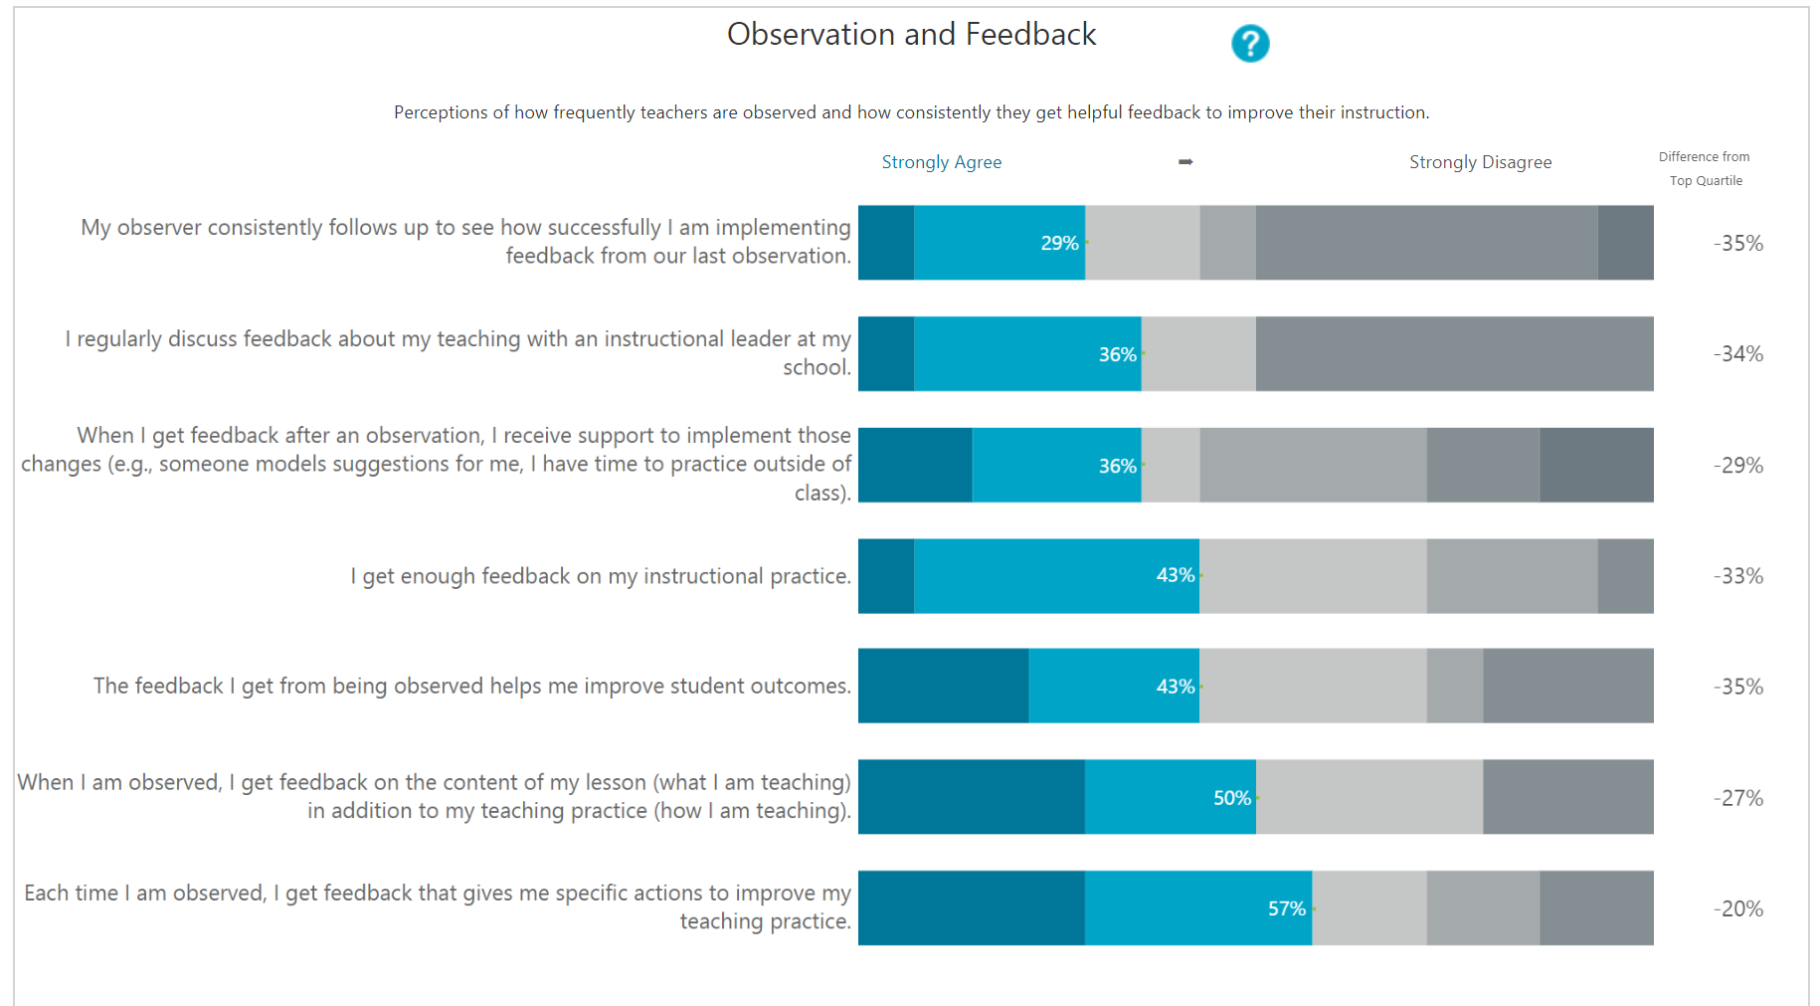
Opportunity for Improvement: Observation and Feedback
Update:
Replace “Observation and Feedback” in the title with the opportunity for improvement you identified.
Update:
Delete this screen shot and replace with a screenshot from your school report. Click here for a tutorial on how to cut/paste a screen shot using the Snipping Tool.
Notes:
“Prior to the meeting the leadership team selected an area of improvement to discuss further. <Provide rationale for why this was selected> Here you can see all of the data within our prioritized domain. I want you to see the complete set of results here, because these are data points we can use to outline a plan for improvement.”
Consideration for Day of Session: It’s possible that during the discussion on Slide 10 teachers elevated different areas for improvement. Be aware of other Domains teachers may want to discuss deeper and determine how the discussion may need to shift in response. Ex. You may choose to discuss a different or additional Domain today, or you may communicate that you plan to create space in a future meeting to dive deeper into the areas teachers raised during the discussion.

Slide 15
Opportunity for Improvement: Observation and Feedback
Update:
Replace “Observation and Feedback” in the title with the opportunity for improvement you identified.
Update:
Delete this screen shot and replace with a screenshot from your school report. Click here for a tutorial on how to cut/paste a screen shot using the Snipping Tool.
Notes:
“Prior to the meeting the leadership team selected an area of improvement to discuss further. <Provide rationale for why this was selected> Here you can see all of the data within our prioritized domain. I want you to see the complete set of results here, because these are data points we can use to outline a plan for improvement.”
Consideration for Day of Session: It’s possible that during the discussion on Slide 10 teachers elevated different areas for improvement. Be aware of other Domains teachers may want to discuss deeper and determine how the discussion may need to shift in response. Ex. You may choose to discuss a different or additional Domain today, or you may communicate that you plan to create space in a future meeting to dive deeper into the areas teachers raised during the discussion.

Slide 16
Unpacking Our Area for Improvement
Update:
Replace the subheader with a summary of one area for improvement for a deeper look.
Update the talking points to reflect your area of focus, and your school’s context.
What is the impact on teachers, and on students, of weakness in this area?
What does success in this area look like to you?
What has been missing in this area?
What are the highest priority actions we should be taking?
Teachers aren’t experiencing consistency with their peers or respect between students and adults
Consideration:
If you have a second area for improvement you would like to address with teachers, duplicate this slide and update as necessary.
Optional Update:
Update these questions to reflect what you would like to discuss with teachers.
Notes:
“Based on your feedback, it’s clear to us that we need to address [selected domain] in our school, immediately. Before the leadership team moves forward in finalizing our plan of action, I’d like to unpack this topic with you, to ensure we’re getting all of the feedback you have to offer. The survey data has helped elevate this as a priority, and this conversation will help me to fully understand where we need to go.”
FACILITATION NOTES
The discussion questions here are intended to draw out more information regarding the area of improvement as seen by teachers, and to solicit additional ideas for creating positive change.
Suggested facilitation:
1 – break teachers into 4 groups, and assign each group one question to address.
2 – allow groups 5 minutes to discuss their question, and then allow each group 1 minute to share out their discussion, and others in the room have 1 minute to comment, question, or add to the shared ideas.
As groups share, capture their ideas via chart paper or a whiteboard.

Slide 17
Consideration:
This slide is optional.
If your leadership team has thought through next steps, it provides an opportunity for you to elicit teacher reactions/feedback.
Our Goals | Create consistency and respect among teachers and students.
Our Plan | Create a culture-reset across the school, including setting clear expectations for classrooms and all common areas. Teachers will develop a student culture committee to provide the leadership with input, support, and feedback for improving the learning environment across the school. Students will engage in “school citizenship” activities monthly, as developed by the student culture committee.
Our Measures of Success | Improved pro-active culture building in classrooms leading to reduced misbehavior and fewer office referrals.
Leadership Brainstorm for Improvement in Learning Environment
Update:
Outline the Goals and the Plan you have for addressing your school’s area for improvement. The Goal/s should be (a) high-level statements of what success will look and feel like in your school – what’s the impact?
The Plan should include examples of granular steps you will take to make progress towards your goal/s.
Update:
Replace the area of focus in the headline.
Notes:
“As I mentioned the leadership team has reviewed the Insight results together prior to this meeting, and we’ve decided to prioritize this area as one where we want to improve. We have some draft ideas of how to proceed, and I want to share it with you.”
FACILITATION NOTES:
Allow teachers time to read through the content of the slide, 1-2 minutes, then highlight the priorities of your plan.
We suggest writing the Goals and Plan out on chart paper before the session, so that teachers have them available when you transition to the next slide. Alternatively, you may choose to print out this slide in advance for teachers.
Note: Prior to this slide teachers worked in groups to react to the areas for improvement. If they shared pertinent information during that discussion that would merit changes to your plan acknowledge it here and frame “Let’s think about how our discussions today impact this plan. How might we adjust this?” Then next slide provides additional prompts.

Slide 18
Consideration:
This is a follow-up to the previous slide and is optional.
We suggest including this only if you have the capacity to incorporate teacher feedback into your plan to address needs.
Feedback on Our Plan
1
2
3
Update:
Replace “our area for improvement” with the areas for improvement identified on the proceeding slide.
What other aspects of our area for improvement should the leadership team consider?
What else can the school do to improve in this area?
How can teachers support the initiative for improvement in this area?
Notes:
“In order for the leadership team to be successful in our improvement efforts, we need the input of teachers as well. I’d like to hear your reaction to our plan and how we can improve it.”
FACILITATION NOTES
Share all three questions with teachers, and then allow 2-3 minutes for teachers to reply to each one. As teachers reply to each question, record their responses on chart paper or white board.
BEST PRACTICE IDEA:
Type up teacher responses to these items, and email to teachers after the meeting.

Slide 19
Our Agenda
Introduction to Insight 5 minutes
Overview of our results 15 minutes
Unpacking our area for improvement 15 minutes
Q&A 5 minutes
Closing 5 minutes
Optional Update:
Adjust the timing on this slide, and all subsequent agenda slides, to match your planned session pacing.
Notes:
“Let’s take a few minutes now to open the floor for any questions or additional comments you may have. We can talk through any of the results shared today or about any of the ideas we have for improving in the future. If you have any questions about the survey itself, I’ll do my best to answer, but if I don’t know, I’ll tell you that and reach out to the Insight team to see if I can find out.”

Slide 20
Our Agenda
Introduction to Insight 5 minutes
Overview of our results 15 minutes
Unpacking our area for improvement 15 minutes
Q&A 5 minutes
Closing 5 minutes
Optional Update:
Adjust the timing on this slide to match your planned session pacing.
Notes:
“Let’s close out by reviewing our objectives, and a short exit ticket to solidify what we’ve talked about today.”

Slide 21
Optional Update:
Update to match the objectives on the first slide.
Objectives
Together we will:
Review our school’s Insight results and discuss teacher and leader reactions
Identify strengths and opportunities for growth; and
Discuss strategies for improvement
Notes:
“Again, I thank you all for your feedback, and for your engagement during this session. I encourage you to follow up with me with any additional questions or ideas you may have.”

Slide 22
Please complete the exit ticket and leave it behind
Optional Update:
Modify these question to reflect the ideas you’d like to collect from teachers
What is one idea you heard in today’s discussions that you'd really like implemented?"
How would you like to contribute to supporting the improvement efforts we discussed today?"
Notes:
“We wanted an opportunity to capture some final thoughts on today’s discussion and to think about how you would like to contribute to supporting our efforts to improve our school’s culture.
Please answer the following questions and leave _______ before you leave. I’ll be following up with you all soon to keep you updated on our next steps.”
FACILITATION NOTES
Collect exit tickets from teachers at the end of the session, and take time to review their responses.
Consider how you might acknowledge the responses in your follow-up communication.

Slide 23
Facilitator Notes: After the Meeting
Follow up after the meeting with an email thanking teachers for their candor and to share what you learned from the discussion.
Commit to 2-3 next steps the leadership team will take in response to the feedback and offer opportunities for teachers to engage in those initiatives.
A customizable email template is available on our Insight Help Center.

